Slide 1
YOUR FACE’S PARTY
PREDICTING A PERSON’S POLITICAL PARTY BY THEIR FACE
Casimir von Arx, Gabriel Graf, Malte Sandow, Marco Schaub

Slide 2
WHAT DO WE WANT TO DO?
The idea is silly: Can we predict the party a person is most likely to affiliate with by their picture?
There are pictures of Swiss national politicians available on the internet we can use to train a model.
To demonstrate the model, we can use pictures of other well-known personalities.
Notes:
Marco

Slide 3
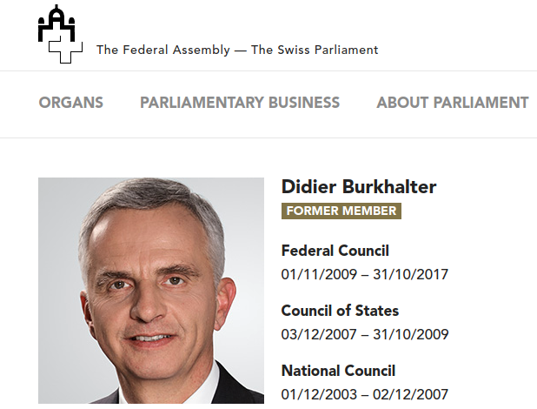
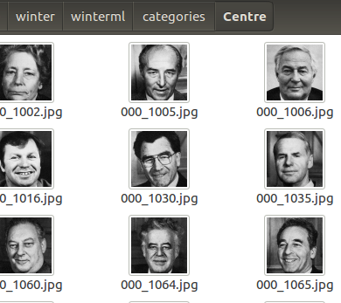
DATA ACQUISITION
Structured data from parlament.ch
Sharepoint structure -> less than perfect tooling
Local PC
parlament.ch
(Sharepoint DB)
Selenium (Chrome)
HTMLParser.py
Sorted Directories by category/party
Notes:
Malte

Slide 4
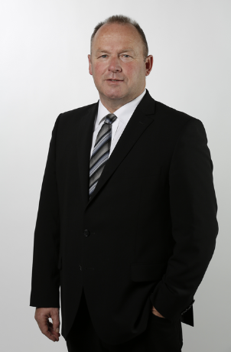
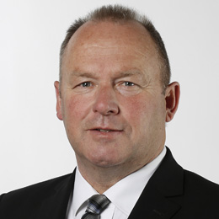
DATA QUALITY AND BIASES (1)
(+) Some standardization measures were already applied by Parliamentary Services:
Original pictures cropped to show face
Original pictures cropped to square shape (260 px * 260 px)

Slide 5
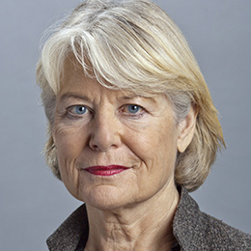
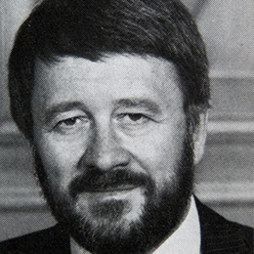
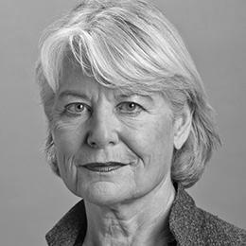
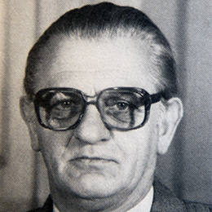
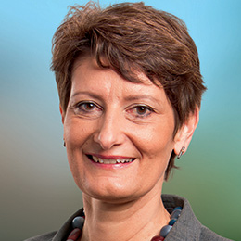
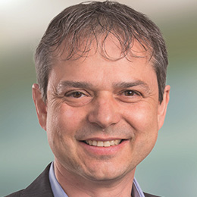
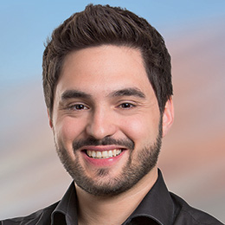
DATA QUALITY AND BIASES (2)
(–) Pictures exhibit properties that may result in the
neural network adapting to misleading features:
Older pictures are not coloured (solution: convert all images to greyscale)
While most pictures have a neutral background, some do not (wooden wall, party’s corporate design)
Photographers’ style
Notes:
Verwendete Bilder
Oben: Verena Diener Lenz, 2044; Walter Röthlin, 1047
Unten links: Toni Cantieni, 1009 (CVP)
Unten Mitte: Ursula Schneider Schüttel, 3028; Philipp Hadorn, 2792; Cédric Wermuth, 2759 (alle SP)

Slide 6
MODEL CHOICE
facenet (github.com/davidsandberg/facenet)
trained vgg_face2 (3.3 million faces/9000 Identies
inception resnet v1
imagenet (tfhub.dev/google/imagenet/inception_v3/feature_vector/1)
trained on imagenet (14 million objects, 20’000 categories)
inception V3
Notes:
imagenet with one fc layer and augmentation (flipping, scalling, cropping) and bottleneck caching → faster
facenet with two fc layer and no augmentation → no caching, slow

Slide 7
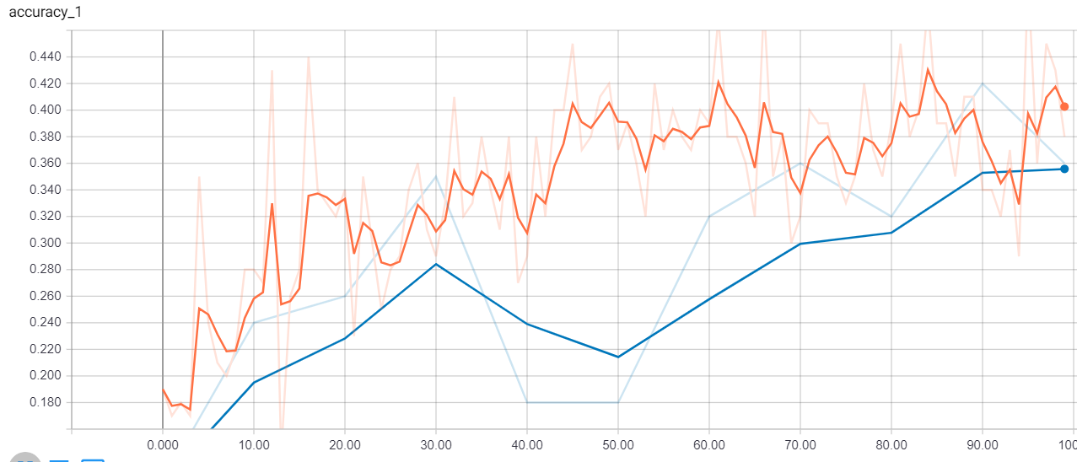
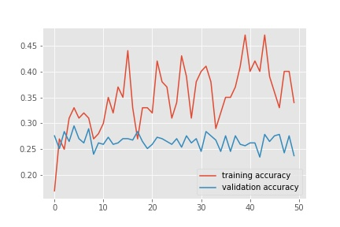
MODEL TRAINING
imagenet with 100 epochs
Validation accuracy 36% Random = 16.7%
facenet with 50 epochs
Validation accuracy 24%
Random = 16.7%
Notes:
Gabriel, Malte, Marco

Slide 8
TRAINING QUALITY
Estimated mean and standard deviation for final test accuracy (3 labels „Left“, „Centre“, „Right“, all politicians)
10 epochs: average accuracy not much better than guessing
30 epochs: a bit better than guessing
Notes:
Solution: more cpu/gpu power to do more epochs per iteration.

Slide 9
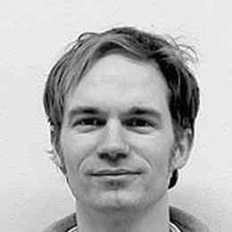
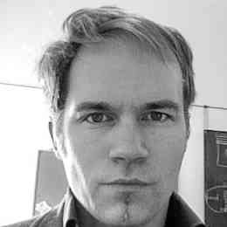
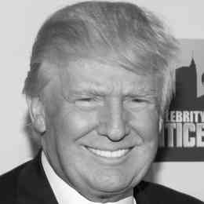
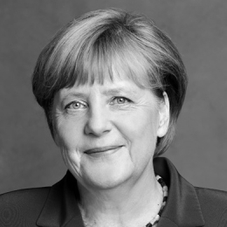
DEMO CASES
CVP 10.8%
SVP 12.9%
SP 23.8%
FDP 10.2%
GP 33.1%
13.9%
16.1%
19.2%
13.8%
27.7%
19.3%
29.9%
12.0%
19.6%
10.6%
7.0%
12.9%
24.2%
7.0%
49.3%
Notes:
Gabriel, Malte

Slide 10
NEXT STEPS (1)
The accuracy of the model is not so high. What to do?
Approach 1: Improve data and model! Get more pictures per person and pictures of local politicians to increase data base size. Standardize background. Separate men and women. Continue to tweak model/parameters.
Approach 2: Give up! It is unlikely you can guess a person’s political affiliation by a picture of his/her face.
Approach 3: Try something else! Maybe guessing political affiliation by clothing produces works better.
Notes:
Casimir, Marco

Slide 11
NEXT STEPS (2)
Practical applications
Augmented reality: Collecting signatures for a referendum, it would help to have an app that marks people who are more likely to respond positively.
Photo optimization: Politicians could use this information to either slightly change their picture to fit their voter base or at least find out which of their pictures would appeal the most to their voter base.
Art: At an exhibition in Munich, an artist used a so-called «Smile to vote»-Wahl-o-mat as a provocation in order to initiate an informed discussion on artificial intelligence.
Notes:
https://www.swr.de/swr2/programm/sendungen/journal/per-gesichtserkennung-zum-wahlergebnis-kuenstliche-intelligenz-als-wahl-o-mat/-/id=659282/did=22477516/nid=659282/1xyuwm2/index.html

Slide 12
DISCUSSION

